Slide 1
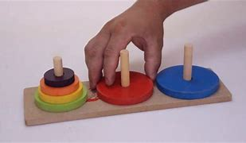
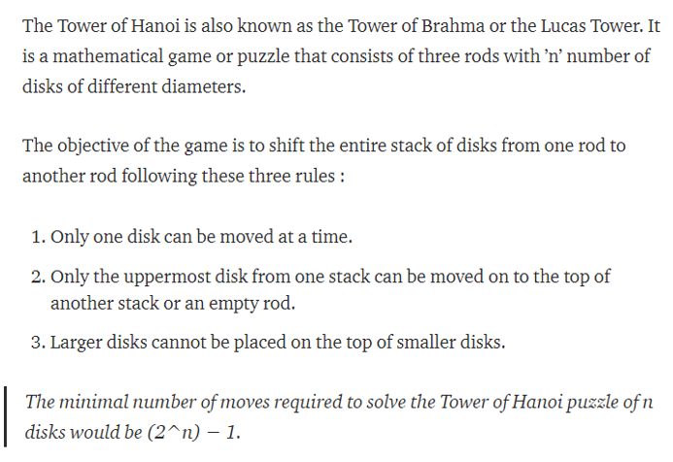
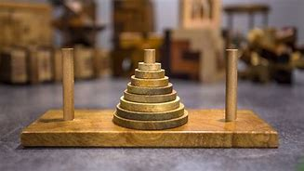

Slide 2
Let’s do it for 1 disk
Source
Destination
Helper

Slide 3
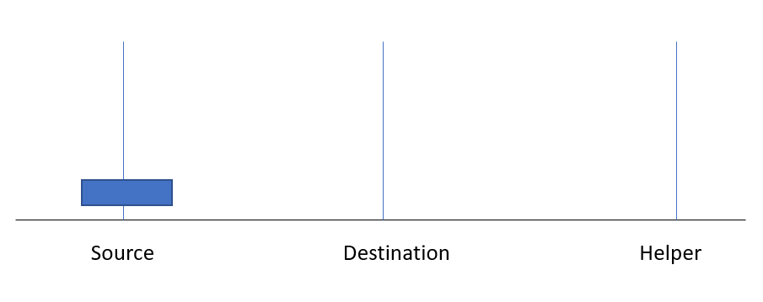
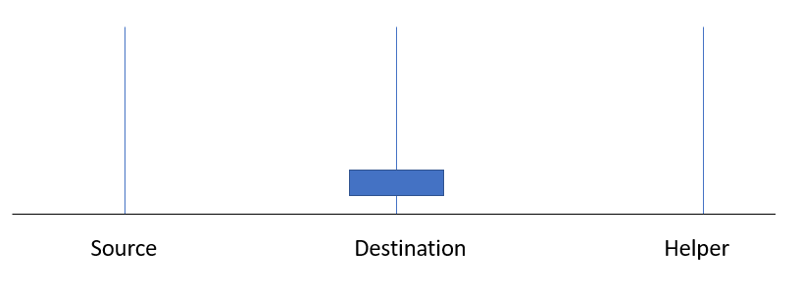

Slide 4
Let’s do it for 2 disks
Source
Destination
Helper

Slide 5
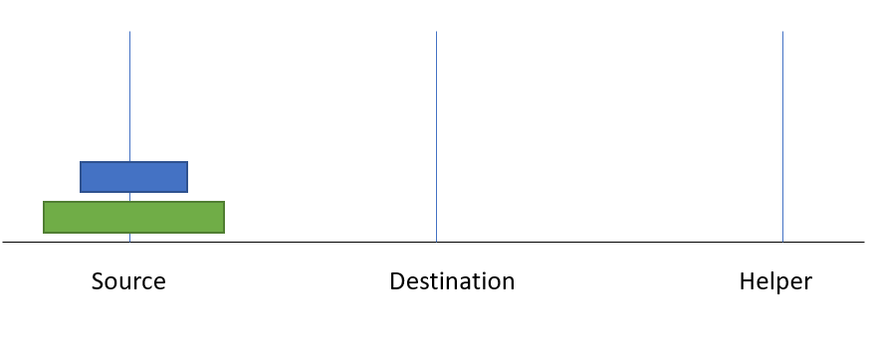
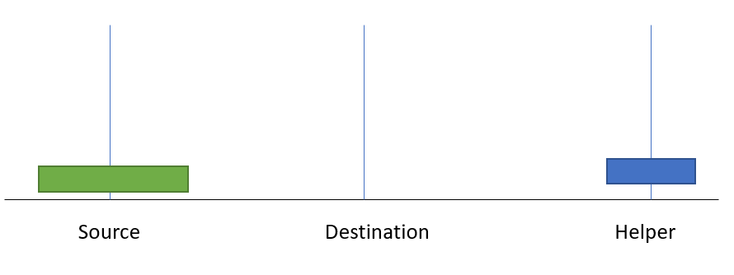
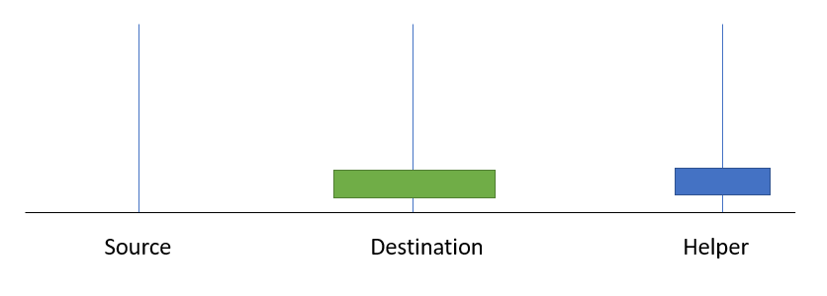
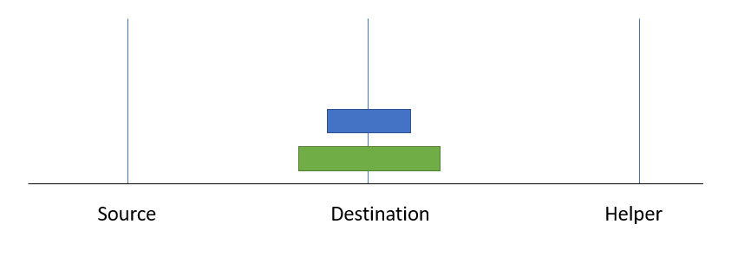

Slide 6
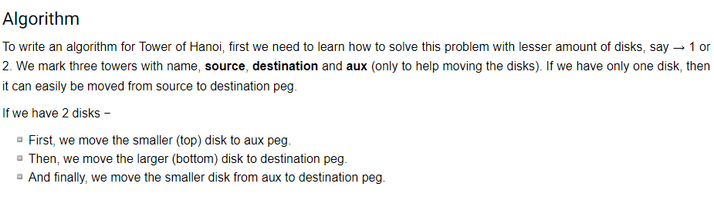
The steps to follow are −
Step 1 − Move n-1 disks from source to helper
Step 2 − Move nth disk from source to destination
Step 3 − Move n-1 disks from helper to destination

Slide 7
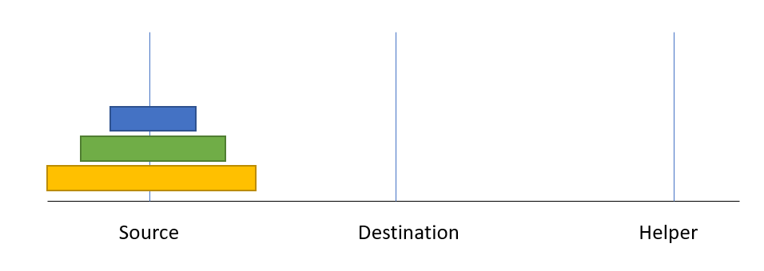

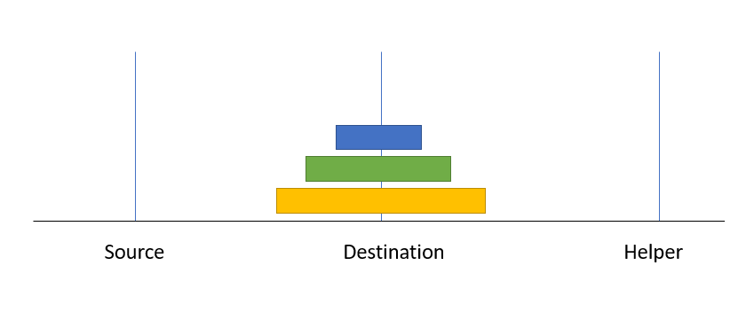
For 3 disks

Slide 8
Let’s do it 3 disks
Source
Destination
Helper

Slide 9
Source
Destination
Helper

Slide 10
Let’s Use Algorithm!!!
The steps to follow are −
Step 1 − Move n-1 disks from source to helper
Step 2 − Move nth disk from source to destination
Step 3 − Move n-1 disks from helper to destination

Slide 11
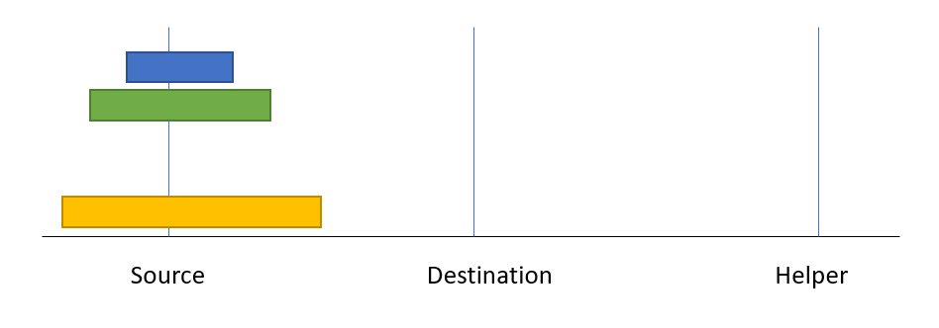
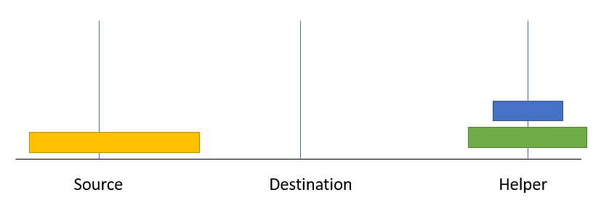
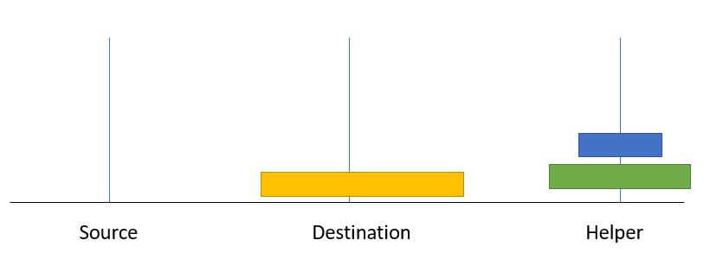
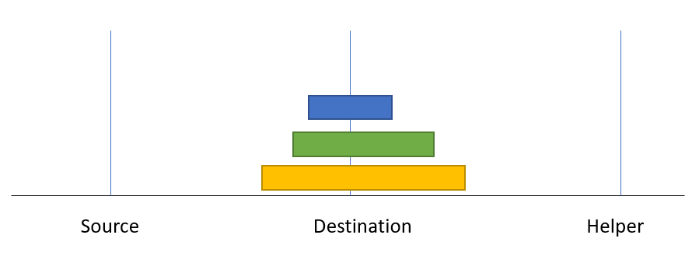
Step 1 − Move n-1 disks from source to helper
Step 2 − Move nth disk from source to destination
Step 3 − Move n-1 disks from helper to destination

Slide 12
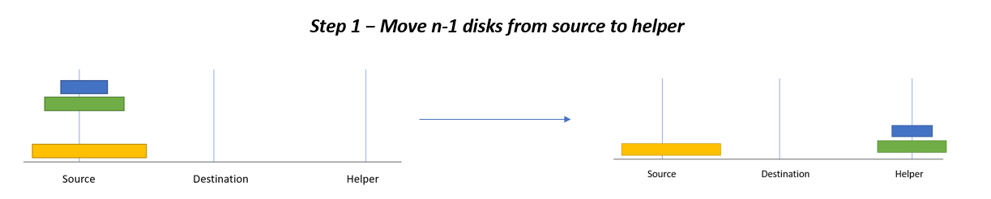
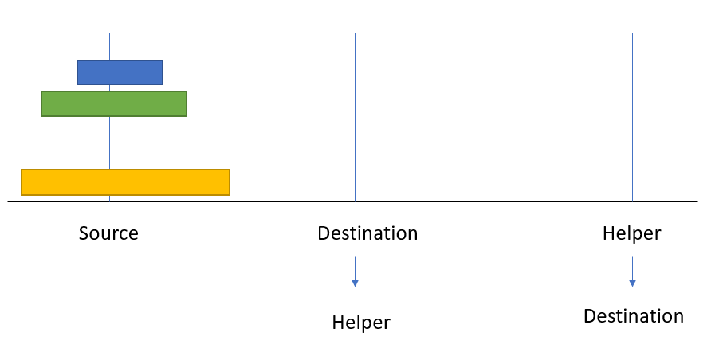

Slide 13
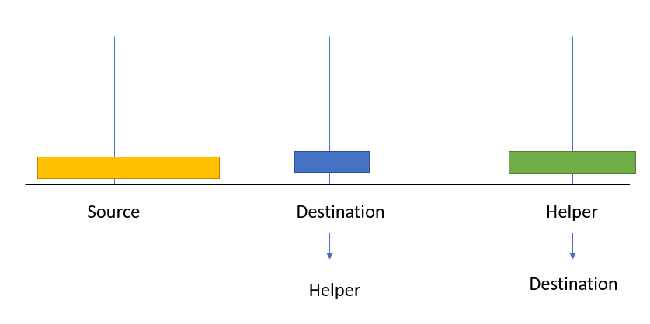
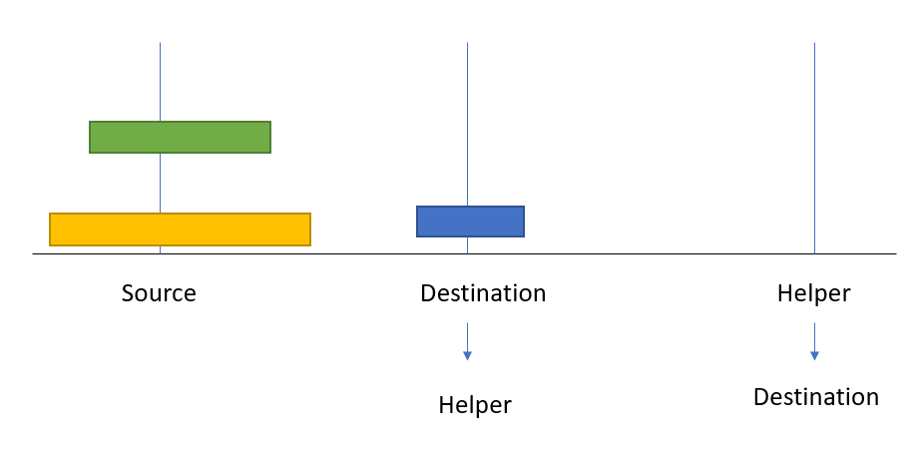
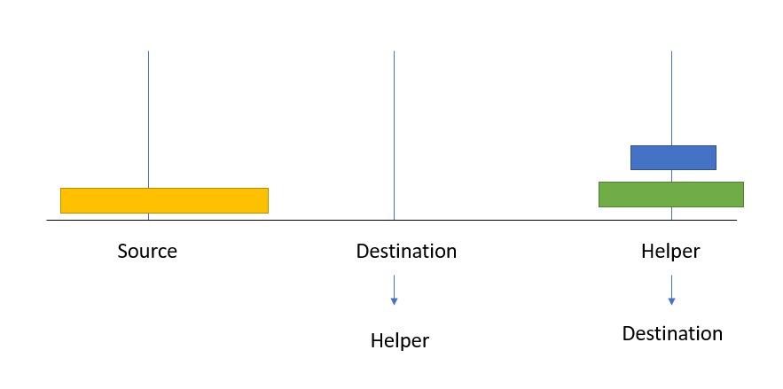

Slide 14
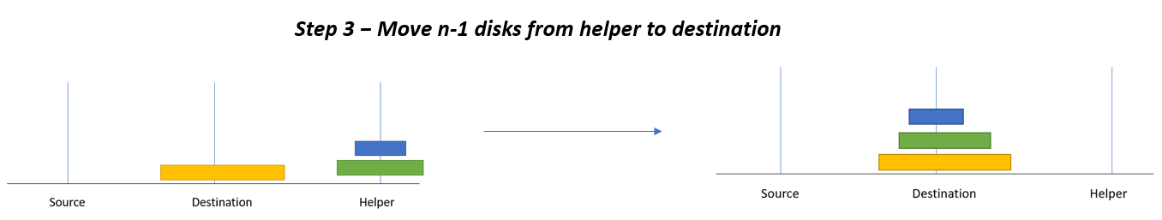
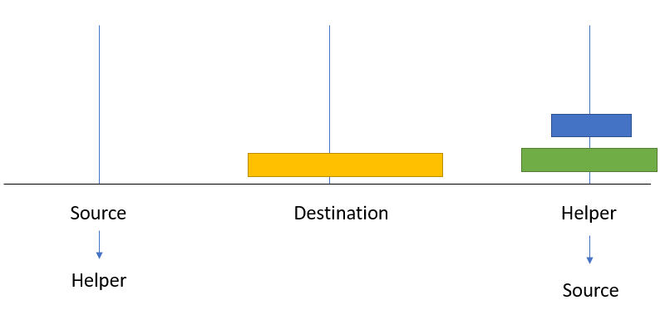

Slide 15
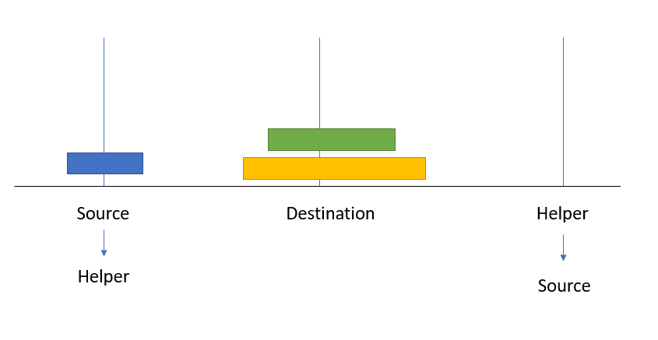
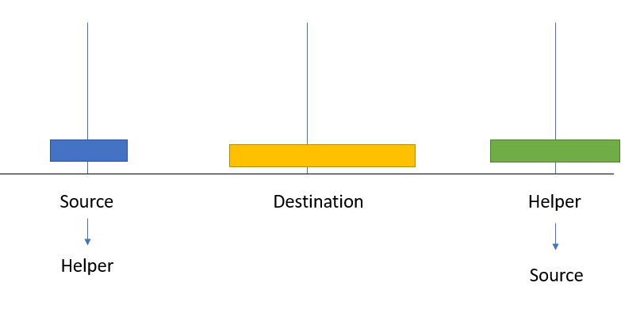
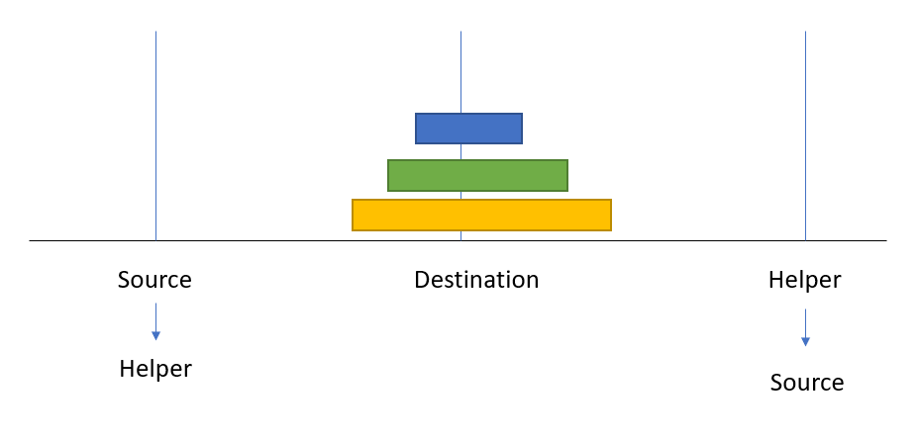

Slide 16
A recursive algorithm for Tower of Hanoi can be driven as follows −
TowerOfHanoi(N, source, destination, helper)
IF N == 1, THEN
Move N from source to destination
ELSE
TowerOfHanoi(N - 1, source, helper, destination) // Step 1
Move N from source to destination // Step 2
TowerOfHanoi(N - 1, helper, destination, source) // Step 3

Slide 17


